Slide 1
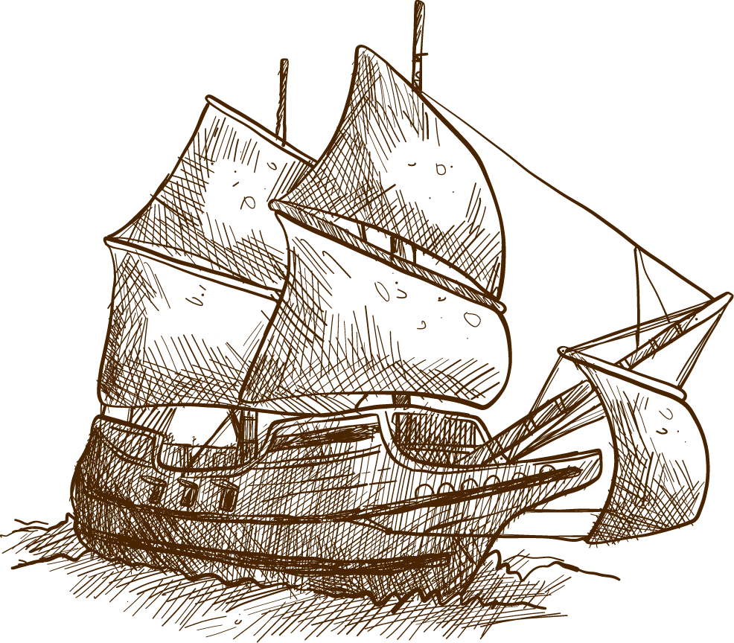
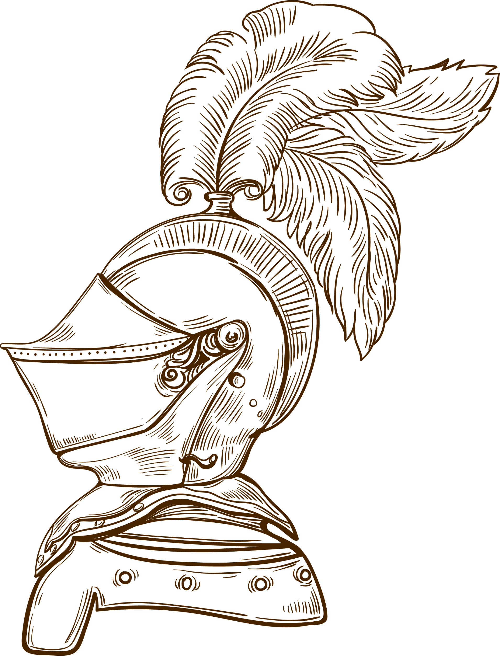

Dynamic Dynasties Map of Indian History
Database Systems
Class CSCE 413/813
School of Computing
University of Nebraska-Lincoln
By:
Sai Vivek Potlapally
Bala Subramanyam Duggirala

Slide 2
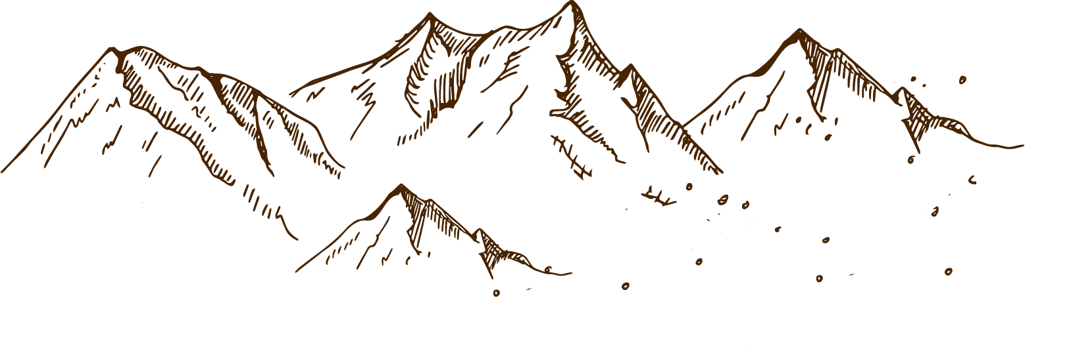
Design Overview
1
Motivation & Goals
2
3
Data Sources
4
Data Transformations
5
Implementation
6
Conclusions/future work

Slide 3
—Mark Twain
“India is a Cradle of the human race, the birth place of human speech, the mother of history, the grand mother of legends and the great grand mother of tradition. Our most valuable and most constructive materials in the History of man are made up in India.”

Slide 4
MOTIVATION
India is one of the most diverse countries in the world with hundreds of languages, tribes and cultures.
Although it had been the meeting ground between the east and the west, no one dynasty could define India in its entirety, given its vast cultural diversity
As citizens of modern India that’s defined by it’s 29 states representing unity in diversity, we wondered how our country took its present shape over centuries of invasions and rule of various dynasties.
GOALS
Our goal is to be able to visually represent different dynasties that have ruled over India over centuries, along with some historically significant data that’s available to query.
We also aim to characterize the dynasties by adding information of various rulers that ruled over a particular dynasty in a given century.
We try to find trends in the distribution of dynasties, for example, the area of the dynasty that remained intact over the centuries, what dynasty did a present-day city belong to back in a given century, etc.,

Slide 5
NameOf
x
cityNames
City
y
id
Name
t
id
id
DName
id
Ruled By
Dynasties
NameOf
NameTable
x
id
To
y
t
Kings
ER Diagram
x
id
Name
From
y
India
t

Slide 6

DATA SOURCES
Maps obtained from:
https://youtu.be/QN41DJLQmPk
Kings Information By Dynasties and tenure:
https://projects.iq.harvard.edu/timeline-southasianhistory
https://en.wikipedia.org/wiki/Gupta_Empire
Map Constraints Obtained from:
I2V2C.m Matlab Script
Implementation and Improvisation:
MLPQ System

Slide 7
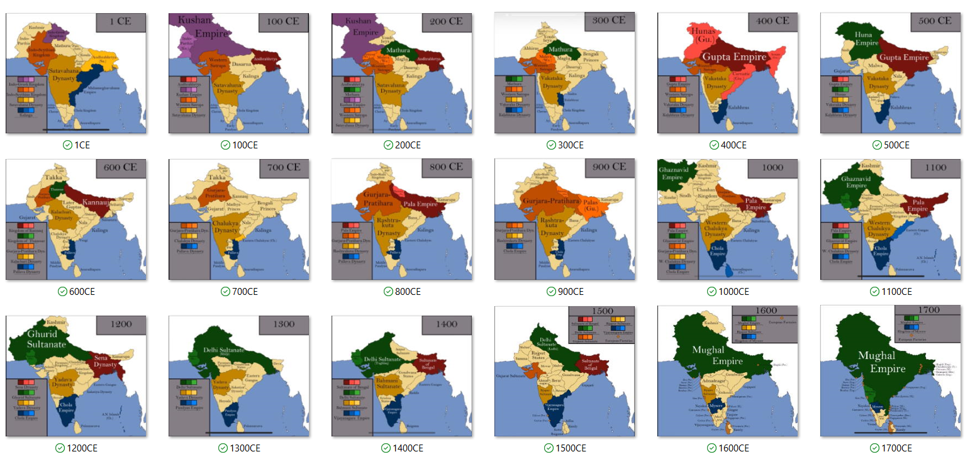
Map Sources

Slide 8





Data Transformations

Slide 9
Dynasties and active Centuries:
Chola
Kalinga
Satavahana
Andhrabhbrtya
Gurjara-Pratihara
Pala
Mathura
0^{th-}3rd , 9th-11th
1st-10th
0th-2nd
0th,2nd -3rd
Gupta
0th-2nd
6th-10th
8th - 11th
4th - 6th

Slide 10
Dynasties and active Centuries:
Chalukya
Pallava
VijayaNagara
Mughal Empire
Kakatiya
Yadava
Delhi Sultanate
6th-11th
5th-8th
14th-16th
13th-15th
16th-17th
12th-13th
12th-13th

Slide 11
SQL QUERIES

Slide 12
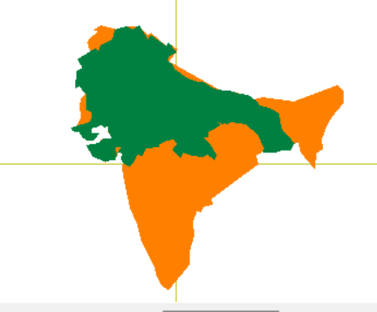
SOLUTION
PROBLEM
Find the part of India ruled by Delhi Sultanate in year 1300
SQL Query
CREATE_VIEW DelhiSultanate_1300
SELECT D.x, D.y
FROM Dynasties AS D, NameTable AS N
WHERE D.id=N.id, N.DName=“DelhiSultanate“, D.t=1300

Slide 13
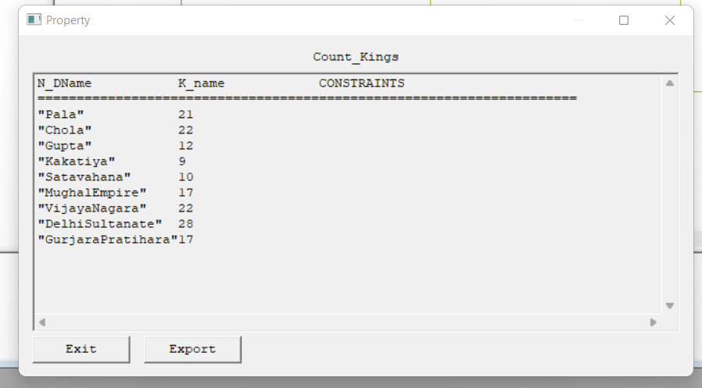
SOLUTION
PROBLEM
Find the number of kings that ruled different dynasties
SQL Query:
CREATE_VIEW Count_Kings
SELECT N.DName, COUNT(K.name)
FROM Kings AS K, NameTable AS N
WHERE N.id=K.id
GROUP BY N.DName

Slide 14
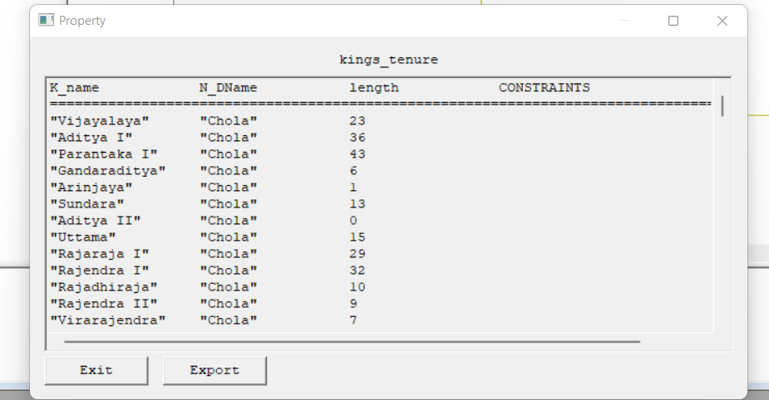
SOLUTION
PROBLEM
Find the names and tenure of the kings who ruled different dynasties
SQL Query:
CREATE_VIEW Kings_tenure
SELECT K.name, N.DName, length
FROM Kings AS K, NameTable AS N
WHERE K.id=N.id, length-K.to+K.from=0

Slide 15
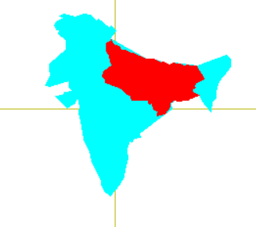
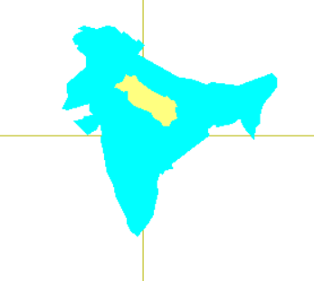
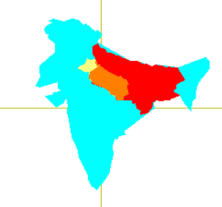



SOLUTION
PROBLEM
Find the part of the Gupta dynasty that remained unchanged through 5th and 6th Centuries
MLPQ Intersect:

Slide 16
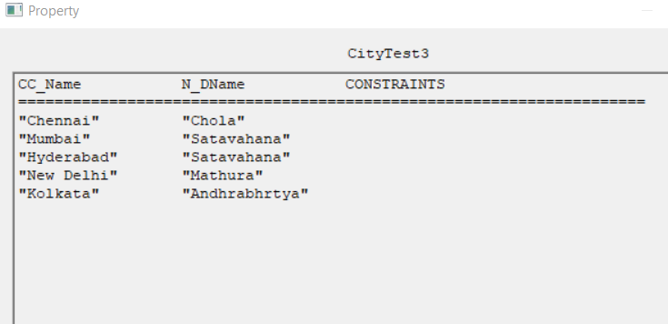
SOLUTION
PROBLEM
Find the dynasties to which modern cities of India belonged to in the 1st century
SQL Query:
CREATE_VIEW City_Dynasties1CE
SELECT CC.Name, N.DName
FROM Dynasties as D, City1 as C, NameTable as N, cityNames as CC
WHERE D.id=N.id, D.x=C.x, D.y=C.y, C.id=CC.id,t=1

Slide 17
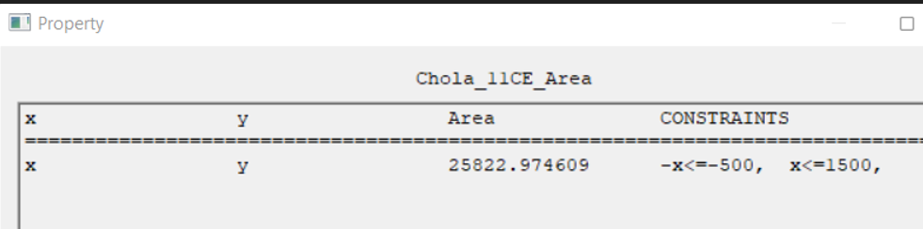
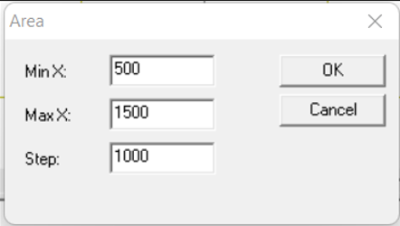
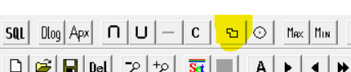
SOLUTION
PROBLEM
Find the area of Chola dynasty in 1100CE.
1. SQL Query:
CREATE_VIEW Chola_1100CE
SELECT id, x, y
FROM Dynasties as D
WHERE D.id=1,t=1100
2. MLPQ Area:

Slide 18
Conclusions and Future Work
With this project, we have been able to represent 15 different dynasties.
This can be extended by adding all other dynasties to create a rich source of historical information about India.
We could also add various smaller details associated with the rulers, capital cities, historical monuments, wars fought etc.
If we take it further into later centuries, we would be able to map these changes to the current division of states in India, their culture, languages, ancestry and other things.

Slide 19
Thank You
Questions are welcome now.

